Slide 1
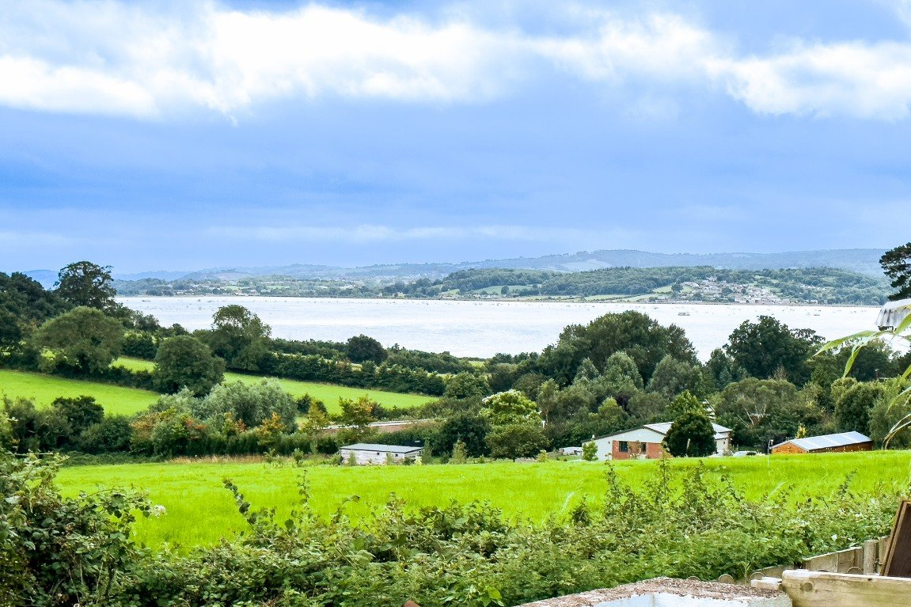
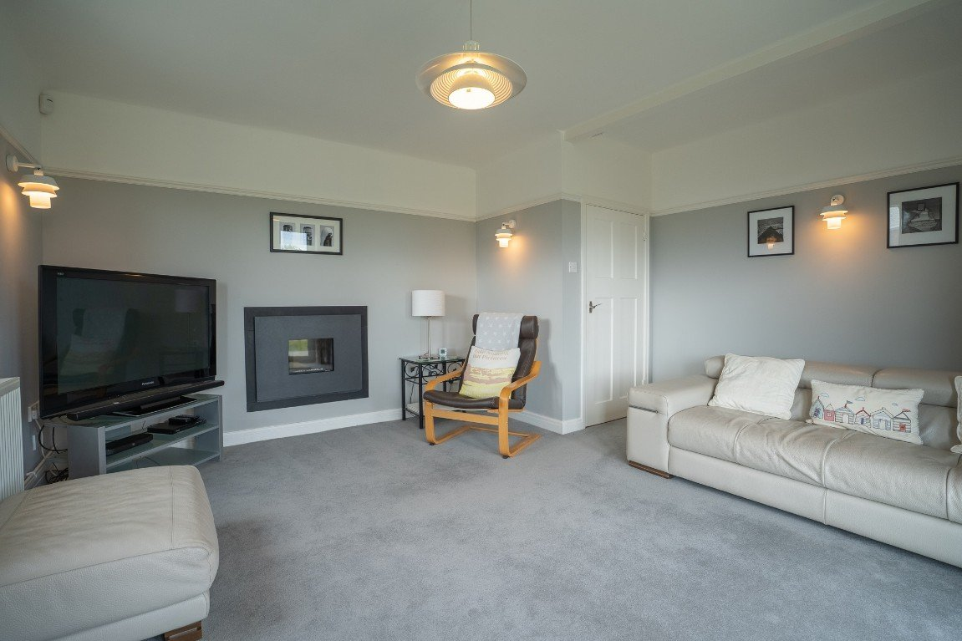
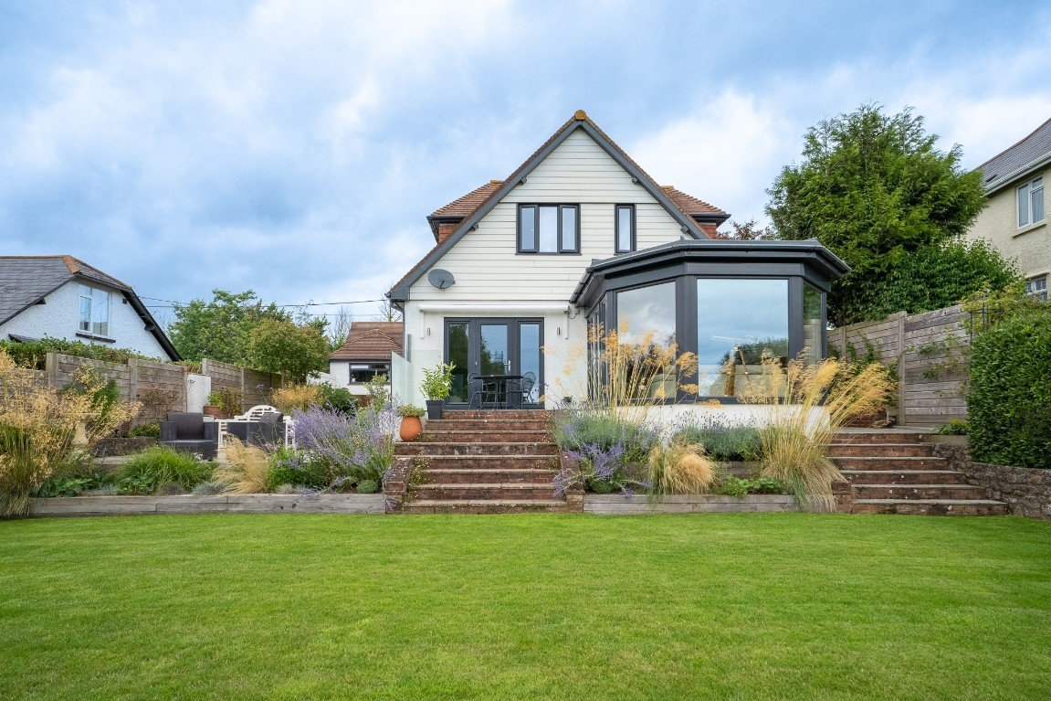
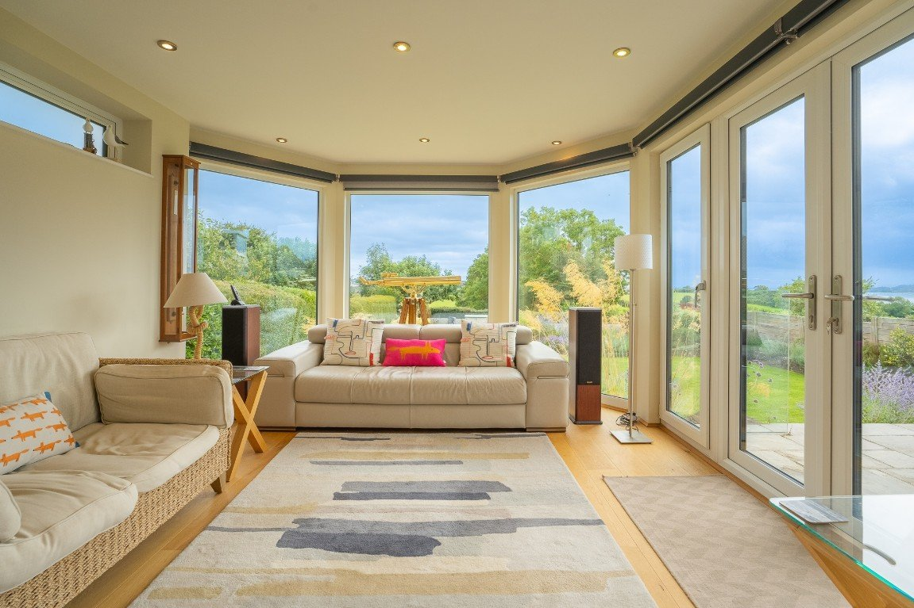
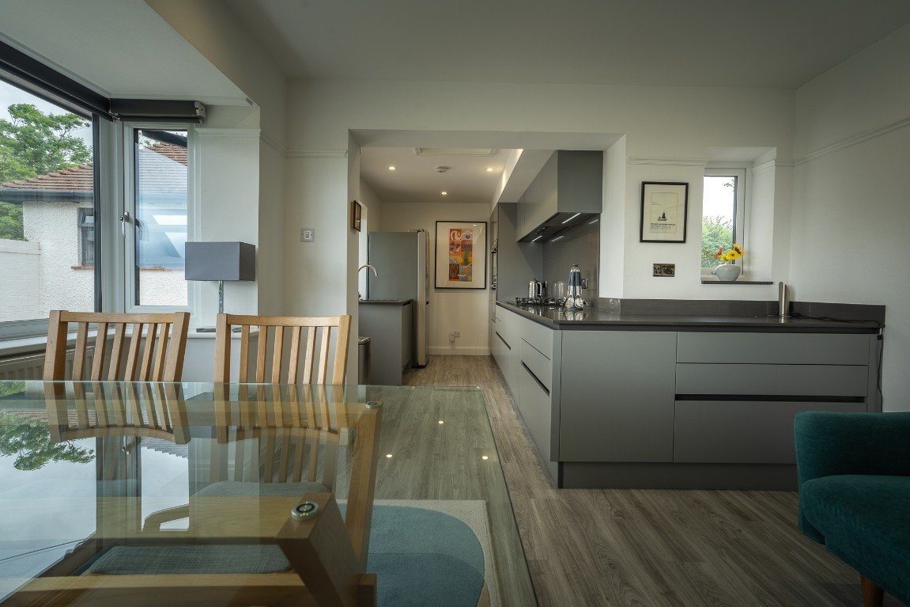
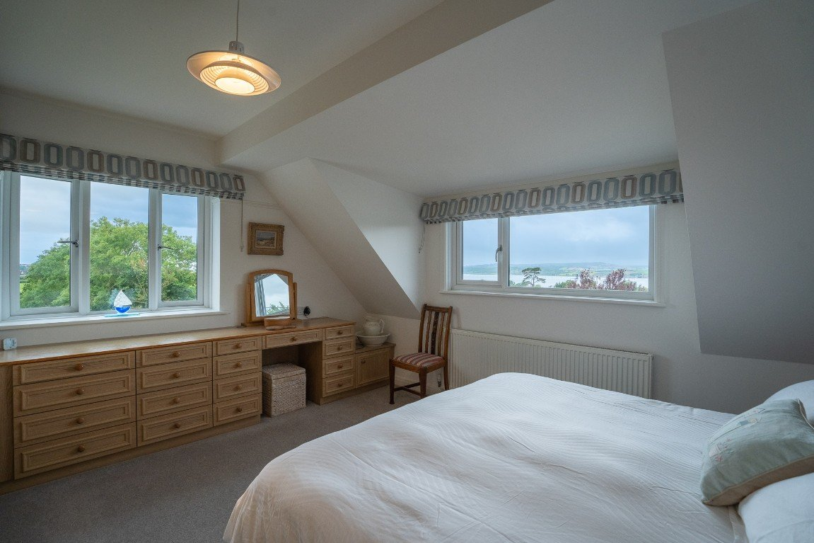
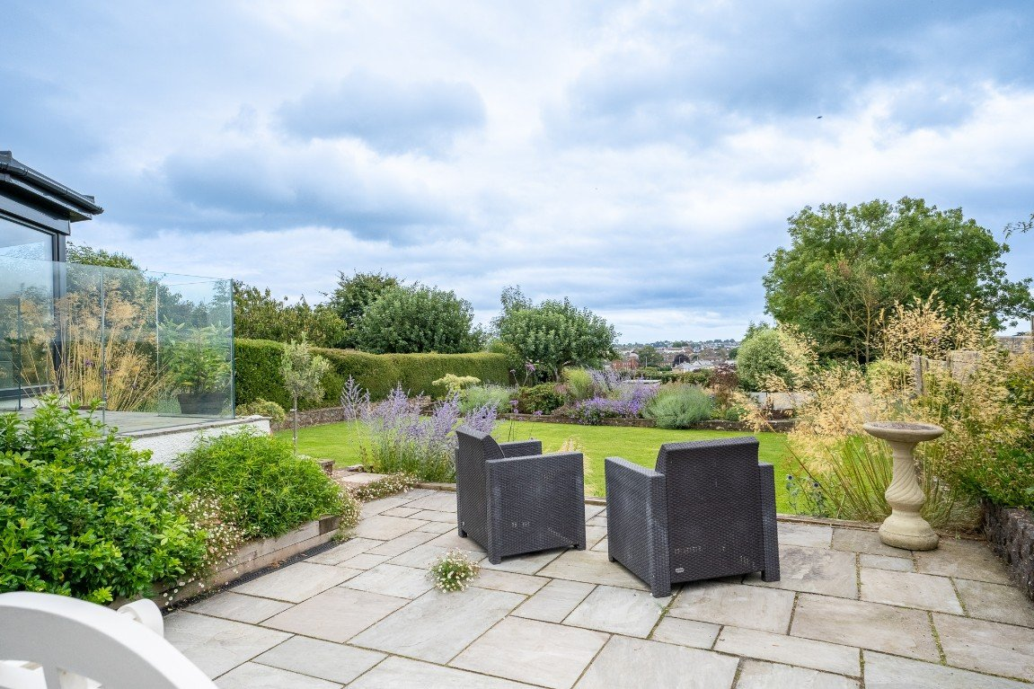
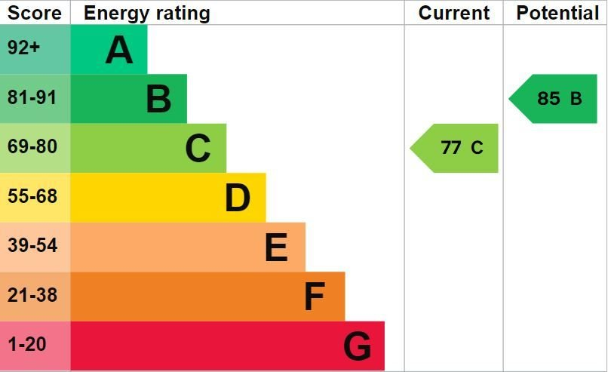
www.pennys.net
The White House, Courtlands Lane, Exmouth, Devon, EX8 3NU
GUIDE PRICE £995,000
TENURE Freehold
An Individual Detached Residence Standing In Good Size Beautifully Tended Gardens And Enjoying A Highly Desirable Location And Enjoying Stunning Views Across National Trust Land Towards The Estuary And Coastline Beyond
Deceptively Spacious And Much Improved Accommodation • Impressive Reception Hall • Attractive Lounge • Stylish Kitchen • Bathroom/WC • Modern Ground Floor Shower Room/WC • Superb Dining Area/Sun Lounge • Much Improved Breakfast Room •
Three First Floor Bedrooms All Gaining Excellent Views • Modern Bathroom/WC •
Triple Glazed Windows And Modern Gas Central Heating System Assisted By Solar Panels •
Pennys Estate Agents Limited for themselves and for the vendor of this property whose agents they are give notice that:- (1) These particulars do not constitute any part of an offer or a contract. (2) All statements contained in these particulars are made without responsibility on the part of Pennys Estate Agents Limited. (3) None of the statements contained in these particulars are to be relied upon as a statement or representation of fact. (4) Any intending purchaser must satisfy himself/herself by inspection or otherwise as to the correctness of each of the statements contained in these particulars. (5) The vendor does not make or give and neither do Pennys Estate Agents Limited nor any person in their employment has any authority to make or give any representation or warranty whatever in relation to this property.
PENNYS ESTATE AGENTS
2 Rolle House, Rolle Street, Exmouth, Devon, EX8 2SN
Tel: 01395 264111 EMail: help@pennys.net

Slide 2
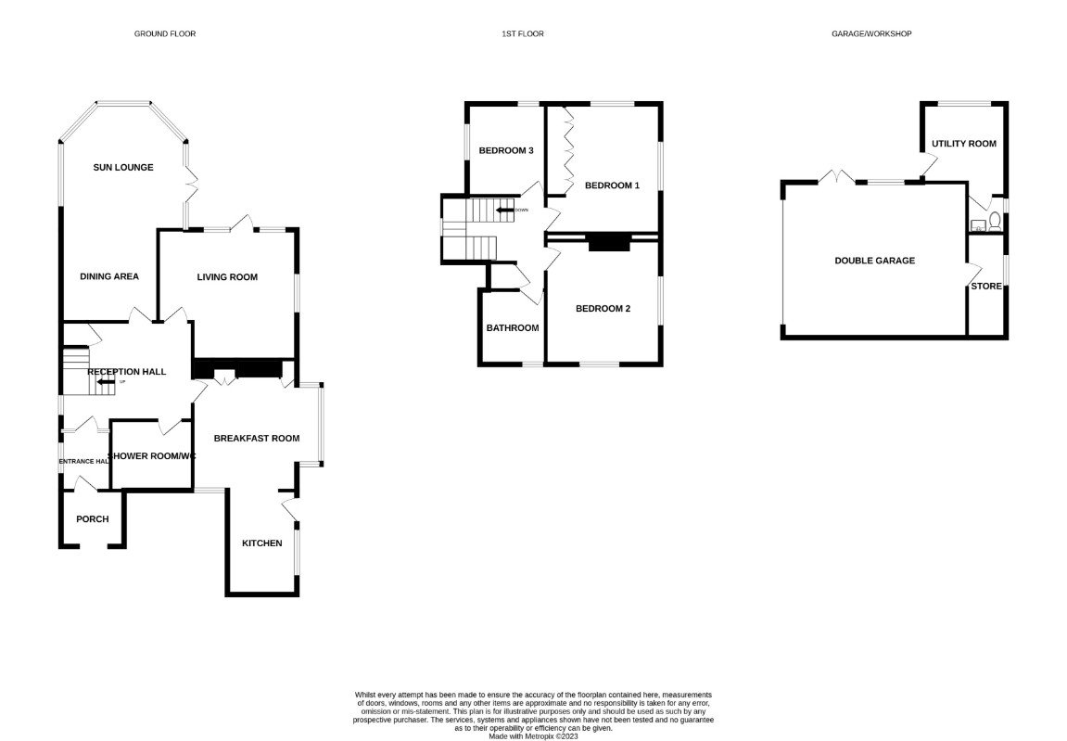
The White House, Courtlands Lane, Lympstone, Devon, EX8 3NU
Courtlands Lane is located on the edge of Exmouth which offers ease of access to both the seaside village of Lympstone and the Cathedral City of Exeter. Lympstone village offers excellent community spirit and enjoys a number of public houses, a well-established primary school, village store and train services operating between Exmouth and Exeter. Michael Caines' Michelin-starred luxury hotel and restaurant is also located close by. The White House is a mature detached chalet style residence situated in the much sought after village of Lympstone with delightful good size gardens and commanding superb views over National Trust Land to the estuary and coastline in the distance. THE ACCOMMODATION COMPRISES: Arched entrance porch with tiled flooring and inner solid wood door giving access to: ENTRANCE HALLWAY: Double glazed window to side aspect; radiator; coat rack; picture rail; inner glazed panelled door leading to: SPACIOUS RECEPTION HALL: 4.44m x 3.23m (14'7" x 10'7") An impressive entrance to the property with turning staircase rising to the first floor landing with triple glazed window to side aspect and useful understairs storage cupboard; radiator housed in feature radiator cover; picture rail. LIVING ROOM: 4.55m x 4.24m (14'11" x 13'11") A charming room with wall mounted living flame effect gas fire; triple double glazed doors (two tilt and turn) giving access to the rear patio sun terrace gaining lovely views over National Trust Land towards the estuary and coastline in the distance; radiator; picture rail; electrically operated blinds; two television points; two satellite points; BT telephone point; cat 5 cable point. KITCHEN/BREAKFAST ROOM: 7.77m x 4.01m (25'6" x 13'2") narrowing to 2.39m (7'10"). A bright and spacious room with feature Cavalio flooring and recess ceiling spotlighting throughout. KITCHEN AREA stylishly fitted with a range of Caesarstone work top surfaces with matching splashbacks; range of base cupboards, drawer units, integrated dishwasher beneath work tops; inset sink unit with food waste disposal unit and integrated drainer; inset five ring gas hob with extractor hood over with light and matching splashback; built-in double oven, grill and microwave with cupboards above and below; upright pull-out larder style cupboard; space for large fridge/freezer; electric consumer unit; triple glazed window; door giving access to side patio sun terrace. BREAKFAST ROOM AREA: With triple glazed square bay window taking full advantage of the estuary and coastline views; arched wall recess with fitted cabinet; telephone point; cat 5 cable point; wall mounted gas boiler providing domestic hot water and central heating housed in cupboard; further triple glazed window to front aspect; picture rail. DINING ROOM/SUN LOUNGE: 7.62m x 3.63m (25'0" x 11'11") narrowing to 3.18m (10'5"). A wonderful bright and spacious room with large picture windows; triple doors (two tilt and turn) opening onto the rear gardens; french window leading to the sun terrace; two radiators; cat 5 cable point; feature wood flooring; recess ceiling spotlighting; wall lighting; further triple glazed windows to side aspect. GROUND FLOOR SHOWER ROOM/WC: 2.59m x 2.29m (8'6" x 7'6") A stylish well appointed suite comprising of an ease of access shower area with shower unit and frosted shower splash screen; wash hand basin set in display surface with cupboards beneath; WC with concealed cistern and push button flush; tiled splashbacks; wall mounted mirror-fronted cabinet; chrome heated towel rail; extractor fan; recess ceiling spotlighting; two triple glazed windows with frosted glass. FIRST FLOOR LANDING: With recess ceiling spotlighting; linen cupboard housing water cylinder and slatted shelving. BEDROOM ONE: 4.24m x 3.81m (13'11" x 12'6") A bright dual aspect room with two sets of triple glazed windows to rear and side aspects both enjoying wonderful views towards the estuary and coastline; radiator; part sloping ceiling; picture rail; built-in floor to ceiling wardrobes with adjoining chest of drawer unit and dressing table area; BT telephone point; cat 5 cable point; television point. BEDROOM TWO: 3.96m x 3.76m (13'0" x 12'4") Another bright dual aspect room with triple glazed windows to front and side aspects again taking advantage of the wonderful views; radiator; part sloping ceiling; picture rail; built-in wardrobe; television point.
BEDROOM THREE: 3.1m x 2.59m (10'2" x 8'6") Two sets of triple glazed windows to side and rear aspects with estuary views; radiator; built-in wardrobes and drawer unit; radiator; picture rail; BT telephone point; three cat 5 cable points; television point. BATHROOM/WC: 2.29m x 1.83m (7'6" x 6'0") A well appointed modern suite comprising of a bath with remote controlled Mira shower unit over and shower splash screen; contemporary style wash hand basin with drawer units beneath and fitted mirror with light over; WC with concealed cistern; chrome heated towel rail; splashback walls; colour coordinated flooring; recess ceiling spotlighting; triple glazed window with patterned glass. OUTSIDE: Enjoying an enviable highly sought after location, the property is approached via a good size PARKING AREA with outside lighting, electric vehicle charging unit and DOUBLE GARAGE. A block paved and patio side pathway leads through to the REAR GARDEN which is a wonderful feature of the property being generous in size and beautifully well tended. Comprising of a variety of shrubs and trees; extensive lawned garden areas; various patio seating areas which take full advantage of the views; raised patio sun terrace adjoining the rear of the property with glass balustrade, electric sun canopy, outside power supply and lighting. To one side of the property there is a block paved pathway with brick built barbecue area, well stocked flower and shrub beds, outside cold water tap and gate giving access back round to the front of the property.
UTILITY ROOM: 2.87m x 2.77m (9'5" x 9'1") With power and light connected; work top surface with plumbing for washing machine; space for tumble dryer beneath; double glazed window; access to WC fitted with Belfast style wash hand basin; WC; window with patterned glass. DOUBLE GARAGE: 6.22m x 5.05m (20'5" x 16'7") With electrically operated up and over door; window; access via loft ladder to LARGE BOARDED ROOF SPACE. To the rear of the garage a door gives access to a FURTHER STORE ROOM: 3.18m x 1.37m (10'5" x 4'6") Window with patterned glass; power and light connected.
AGENTS NOTE: (We are informed by our clients that the property is fitted with solar panels which are owned by the property and feed back to the grid yielding an income last year in excess of £600.00)
FLOOR PLAN:

